Slide 1
BROOM SOLUTIONS: credit card fraud detection
TEAM 2 – DUKSS ANALYTICS:
DHARMI, SHWETA, KEERTHANA, URVAJ, SUNVID
Notes:
Run the presentation as it has animations

Slide 2
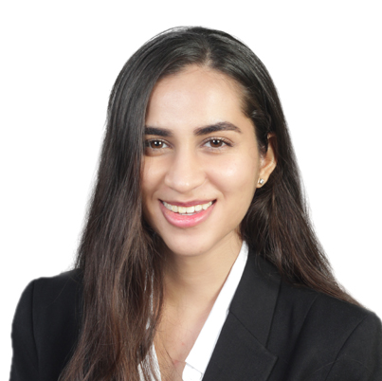
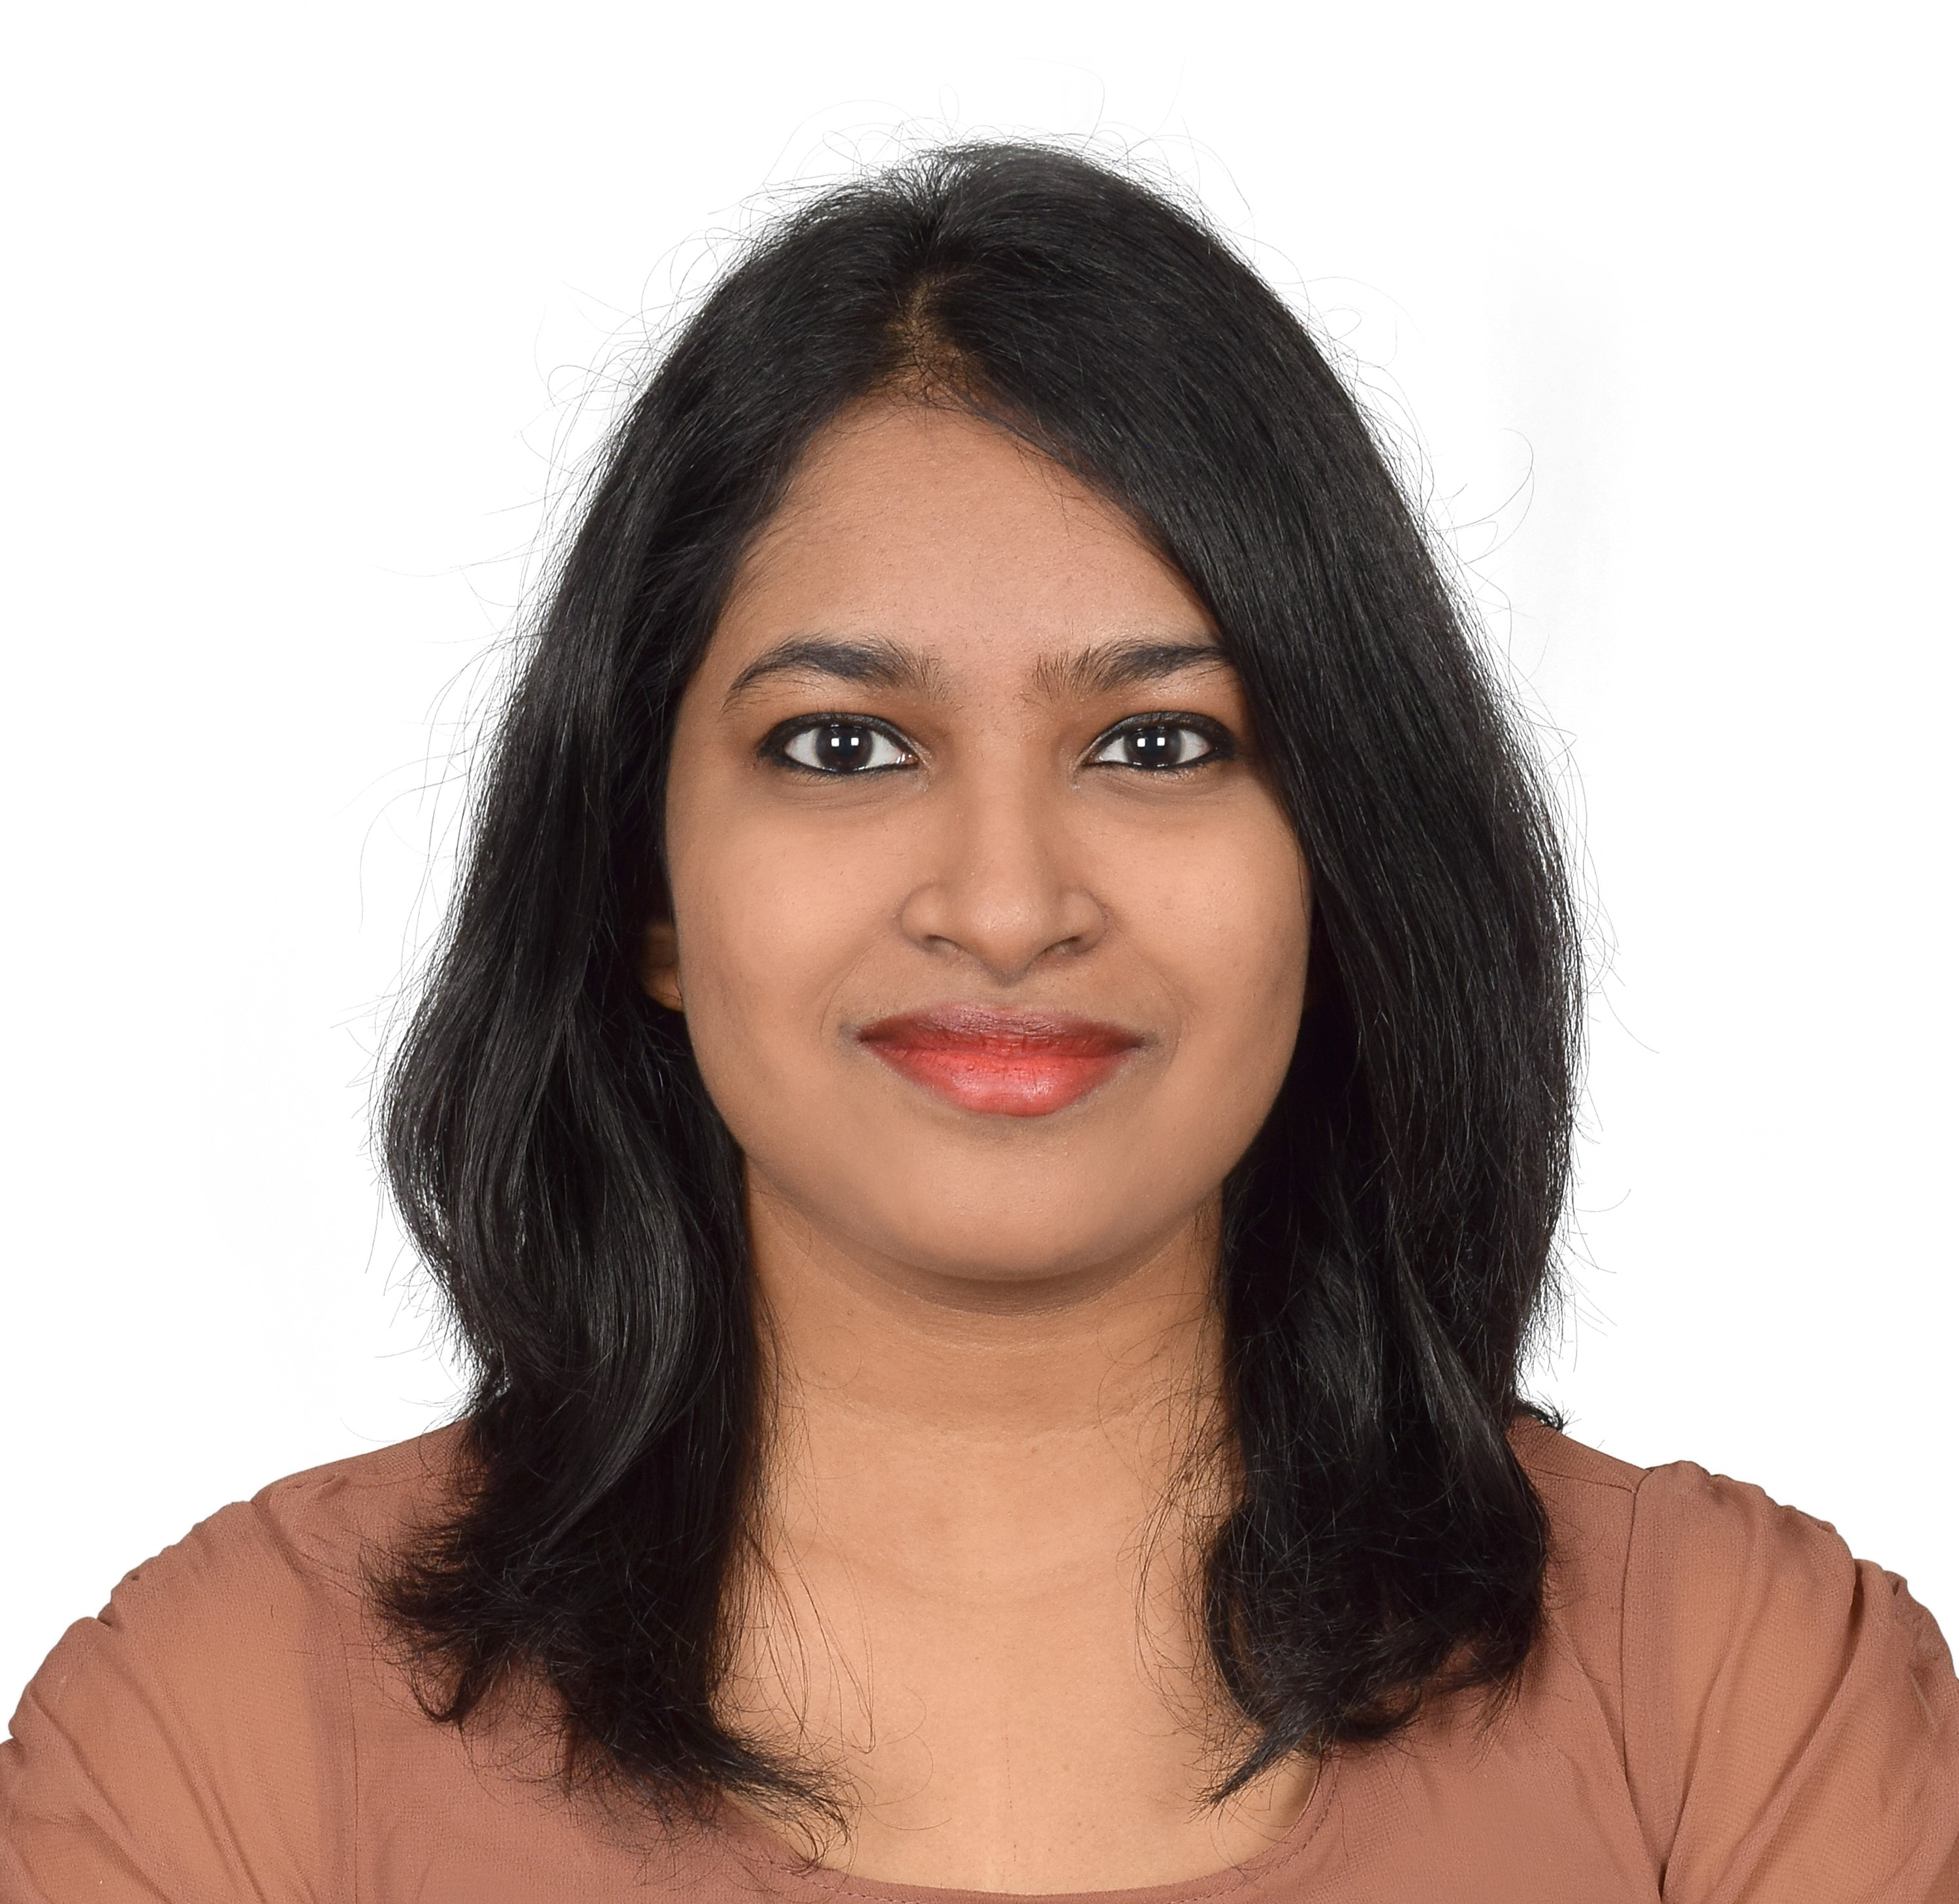
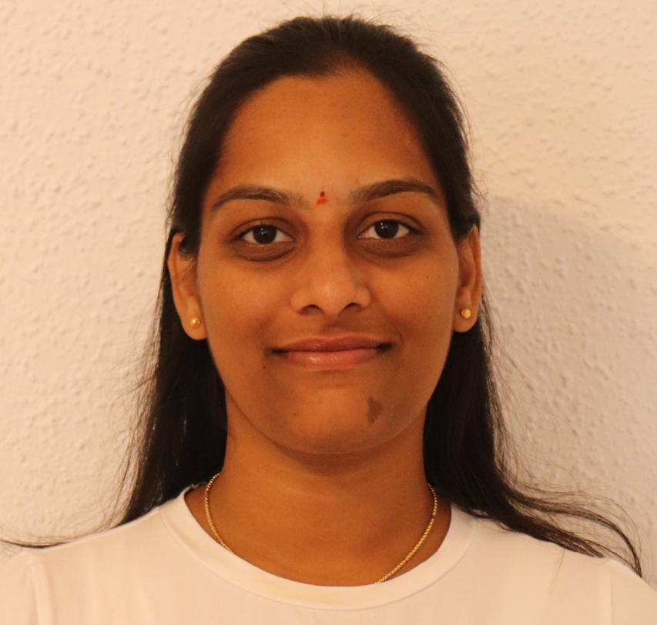

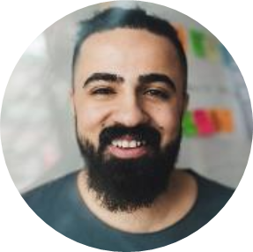
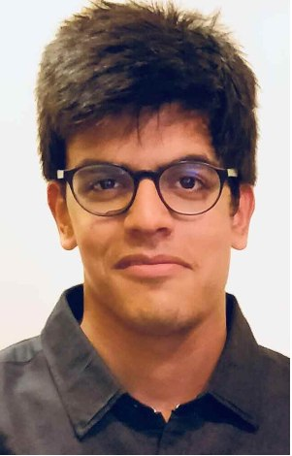
MEET OUR TEAM DUKSS ANALYTICS
Dharmi
Shweta
Keerthana
Manager
Data Visualizer
Data Analyst
Sunvid
Urvaj
ML Engineer
Business Analyst

Slide 3
agenda
BUSINESS PROBLEM
DATA
METHODOLOGY
SOLUTION

Slide 4
BUSINESS PROBLEM
Broom Solutions’ current model is
flagging many non-fraudulent transactions
as fraudulent.
As a result, their
retail clients are frustrated
with the
loss of revenue
and customers.

Slide 5
DATA
“It is a capital mistake to theorize before one has data.”
- Sherlock Holmes in “A study in Scarlet” by
Arthur Conan Doyle
Notes:
Like Shakespeare, we also had a look at the data and derived the following insights to understand the problem better

Slide 6
TRANSACTION PER HOUR
Notes:
Fraud transactions are done at odd hours, mostly when support isn’t available and customers are sleeping

Slide 7
TRANSACTIONS PER CATEGORY
Notes:
Run the presentation as it has animations.
If you look closely at fraud transactions, majority happen for grocery and shopping. Explain why this might be the case.

Slide 8
TRANSACTION AMOUNT
Notes:
If you see transaction amount, $0 is very high most likely as the fraudsters are testing if the card is working. Then, it increases for range of $200-$300 and again for beyond $1000

Slide 9
FRAUD DETECTION DATA SUMMARY
Number of transactions | 18,52,394
Number of non-fraud transactions | ~99%
Number of fraud transactions | ~0.5%
21 features | 1 target variable
No null values in the data
The data is highly imbalanced with ~0.5% of the transactions being fraud.

Slide 10
METHODOLGY

Slide 11
OVERSAMPLING
Since the data is imbalanced with ~0.5% of the transactions being fraud, oversampling was done to balance the data categories better.
Non-fraud
Fraud
Fraud
Non-fraud
Notes:
Random resampling provides a naive technique for rebalancing the class distribution for an imbalanced dataset.
Duplicates of the lesser category are made to make data more balanced.
Advantages:
No information loss like undersampling.
Performs better than undersampling.
Disadvantages:
Likelihood of overfitting as we duplicate the minority class observations.

Slide 12
MODELLING
LOGISTIC REGRESSION
DECISION TREE
Precision | Recall | F1-score
Precision | Recall | F1-score
0.81
0.90
0.85
0
0.85
0.93
0.89
0
1
0.88
0.79
0.83
1
0.92
0.84
0.88
RANDOM FOREST
XGBOOST
Precision | Recall | F1-score
Precision | Recall | F1-score
0
0.86
0.92
0.89
0
0.91
0.95
0.93
1
0.92
0.85
0.88
1
0.95
0.91
0.93
Notes:
Check F1-score for XGBoost & RF

Slide 13


MODELLING
XGBOOST
Precision | Recall | F1-score
$$Precision=\frac{True Positives}{True positives+False positives}$$
$$F1−score=2(\frac{precision ∗recall}{precision+recall})$$
0
0.91
0.95
0.93
XGBoost is the model that identifies a higher number of false positives, which is our main business problem
Precision improvement can tell us if the algorithm performance improved.
1
0.95
0.91
0.93
Notes:
XGBoost is a good option for unbalanced datasets but we cannot trust random forest in these types of cases.
One of the most important differences between XG Boost and Random forest is that the XGBoost always gives more importance to functional space when reducing the cost of a model while Random Forest tries to give more preferences to hyperparameters to optimize the model.

Slide 14
SOLUTION

Slide 15
WHY IMPLEMENT OUR MODEL?
Our model lets us use data like TC40s, SAFE reports, and early dispute notifications
If considering a fraud, will perform 3DSecure to enable customer to verify.
Notes:
Custom api ensures 100% security and encryption after the payment gateway.
to help identify fraudulent charges before they’re disputed reducing false positives.

Slide 16
CURRENT SITUATION
Lost customer lifetime value.
Wasted acquisition costs.
Brand Damage for retailers

Slide 17
ECONOMIC IMPACT
8000 – falsely identified fraud customer
6700 – after model, number of falsely identified customers
Revenue lost for falsely identifying - $160K
With our model, you will be losing - $125K
Results could be seen within 45 days

Slide 18
THANK YOU

